Slide 1

Factors Influencing Student Exam Scores
Group Members:
Baanu Vasundhara Tumma
Laxmi Prasanna Podhem
Vishnu Uday Pavan Medidhi
Mounika Ravella
Mahvish Kounain

Slide 2
FACTORS INFLUENCING STUDENTS’ PERFORMANCE
Hours Studied: Represents the student's dedication and individual effort towards their studies.
1
Attendance: Indicates the student's consistency and commitment to attending classes.
2
Peers' Influence: Reflects the impact of classmates on the student's behavior and mindset.
3
Extra Curricular Activities: Denotes the student's personal choice and involvement in activities outside the academic curriculum.
4
Access to Resources: Dependent on the availability and quality of study materials and support services accessible to the student.
5
School Type: Describes the educational environment provided by the institution, whether public or private.
6
Parental Education: Represents the educational background and the level of support provided by the student's family.
7

Slide 3

RESEARCH QUESTIONS
How does the number of hours study affect students' exam scores?
How does attendance impact students' exam scores?
What is the influence of access to resources on students' exam scores?
How does peers' influence relate to students' exam scores?
What is the effect of participation in extra curricular activities on students' exam scores?
How does school type (public or private) influence students' exam scores?
What is the impact of parental education on students' exam scores?

Slide 4
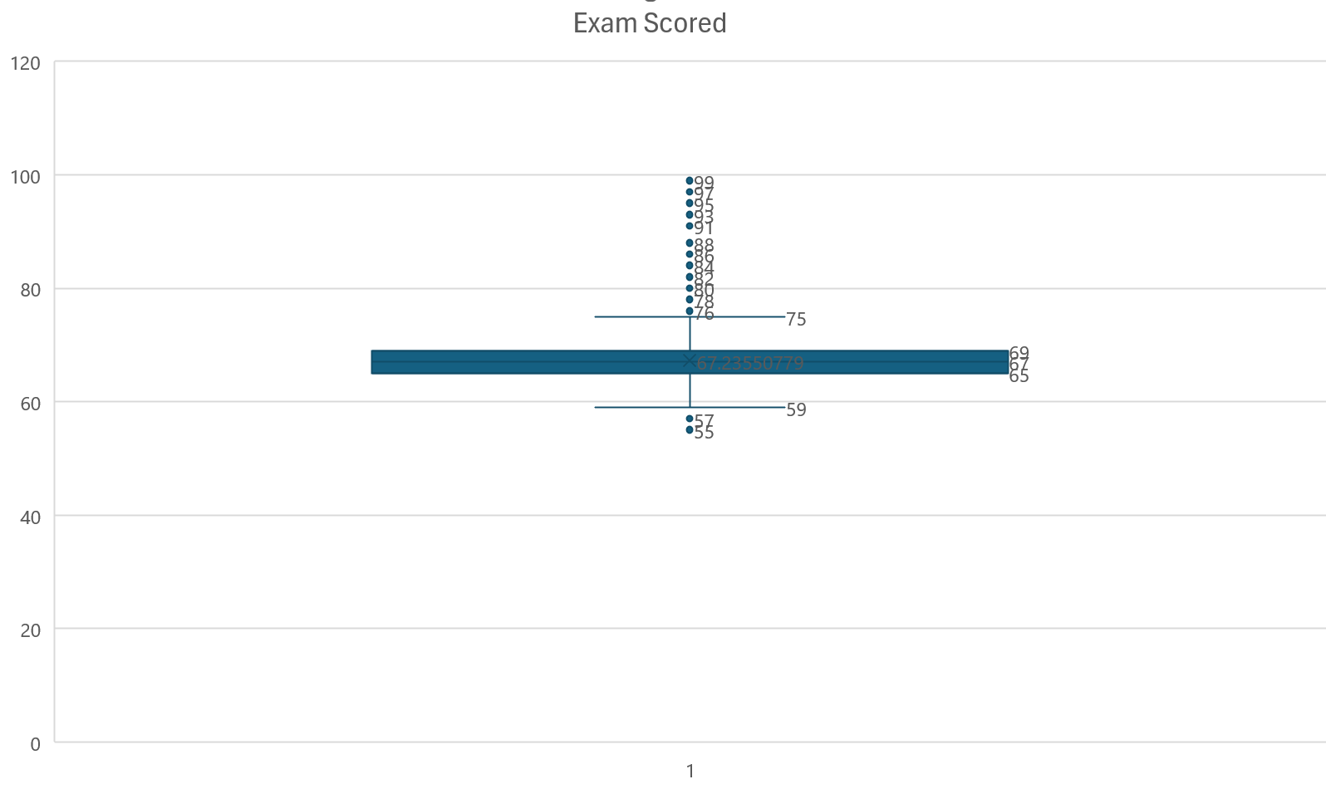
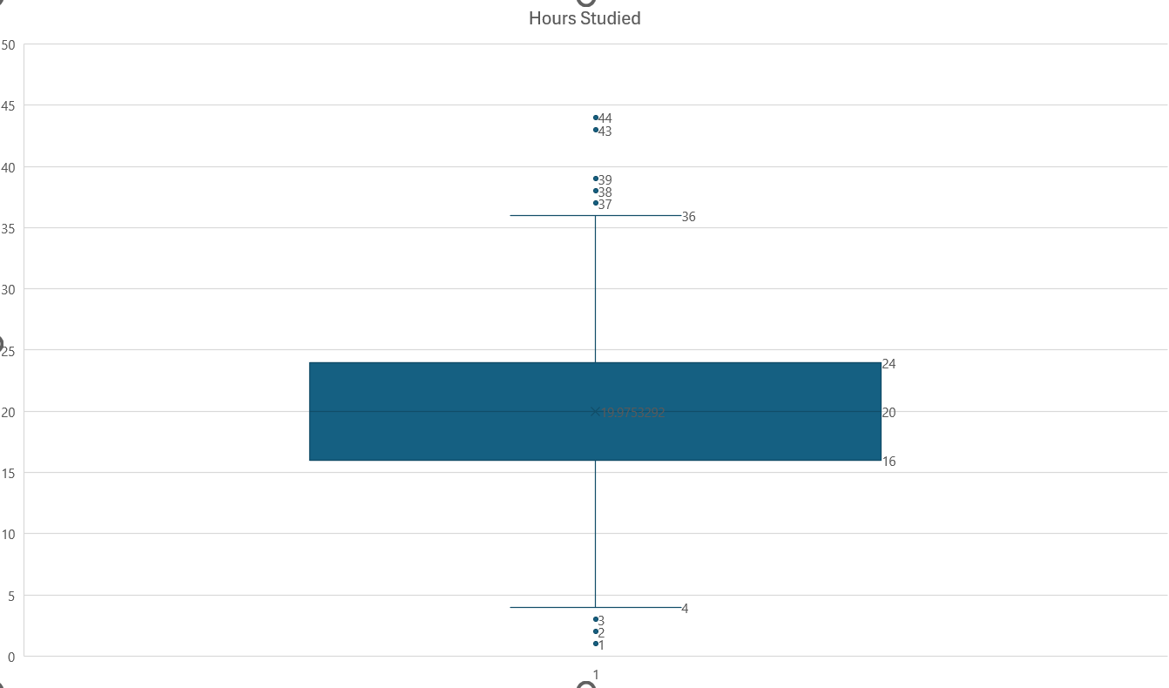
DATA CLEANING
MAKING DATA READY FOR ANALYSIS
Filling missing values with median value
teacher quality 76 blanks
parents’ education 90 blanks
distance from home 67 blanks
Outlier detection
Hours studied: Ignored as there are 8 and few students can study more and less than others
Exam Score: Has one value as 101, considered as input error
Exam Score: no. of students 55 <= score <= 75 is 6531, 76 <=score <=100 is 76. Hence, considering these students performed well and ignoring the outliers.
Recoded Columns into numeric variables

Slide 5

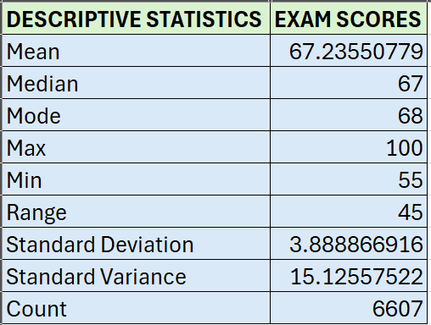
DATA DESCRIPTION
Data Set is from Kaggle https://www.kaggle.com/datasets/lainguyn123/student-performance-factors
No of Records: 6,607
No of Features 22.

Slide 6

OBJECTIVES
Objective 1: Identify key Factors influencing exam scores
HYPOTHESIS 1
Hours studied influence students' exam scores.
Null Hypothesis (H0): Hours studied have no significant effect on students' exam scores.
Alternative Hypothesis (H1): Hours studied have a significant effect on students' exam scores.
HYPOTHESIS 2
Attendance impacts students' exam scores.
Null Hypothesis (H0): Attendance has no significant effect on students' exam scores.
Alternative Hypothesis (H1): Attendance has a significant effect on students' exam scores.

Slide 7
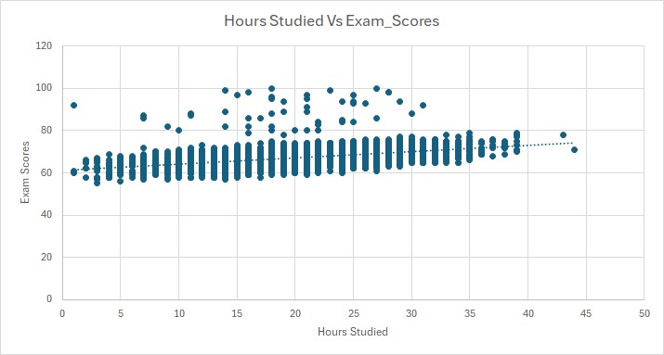
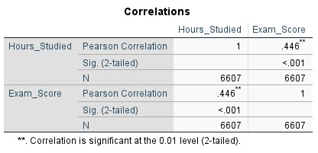
IMPACT OF HOURS STUDIED ON EXAM SCORES
Test Performed: Pearson correlation
Final Statement: Rejecting Null Hypothesis and accepting Alternative Hypothesis.
The Pearson correlation coefficient of .446 indicates a moderate positive relationship between hours studied and exam scores. The correlation is statistically significant at the 0.01 level (p < 0.001), suggesting a strong likelihood that this relationship is not due to random chance.

Slide 8
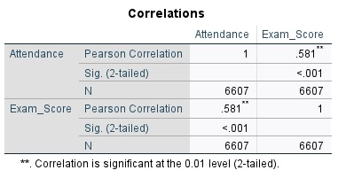
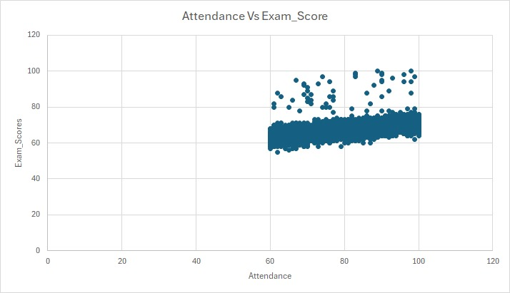
IMPACT OF ATTENDANCE ON EXAM SCORES
Test Performed: Pearson correlation
Final Statement: Rejecting Null Hypothesis and accepting Alternative Hypothesis.
The Pearson correlation coefficient of .581 indicates a moderate positive relationship between attendance and exam scores. The correlation is statistically significant at the 0.01 level (p < 0.001), suggesting a strong likelihood that this relationship is not due to random chance.

Slide 9

Objective 2: Identify Internal Factors influencing exam scores
HYPOTHESIS 3
Peers' influence relates to students' exam scores.
Null Hypothesis (H0): Peers' influence has no significant effect on students' exam scores.
Alternative Hypothesis (H1): Peers' influence has a significant effect on students' exam scores.
HYPOTHESIS 4
Participation in extracurricular activities impacts students' exam scores.
Null Hypothesis (H0): Participation in extra curricular activities has no significant effect on students' exam scores.
Alternative Hypothesis (H1): Participation in extra curricular activities has a significant effect on students' exam scores.

Slide 10
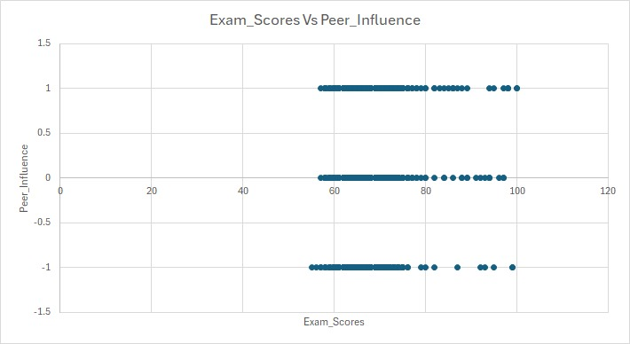
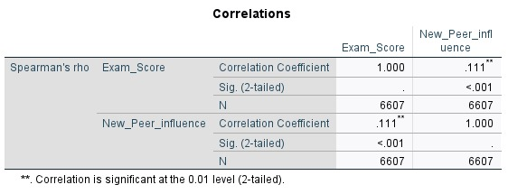
PEER INFLUENCE ON EXAM SCORES
Test Performed: Spearman's correlation
Final Statement: Rejecting Null Hypothesis and accepting Alternative Hypothesis.
The Spearman’s correlation coefficient of .111 indicates a weak positive relationship between peer influence and exam scores. The correlation is statistically significant at the 0.01 level (p < 0.001), suggesting a strong likelihood that this relationship is not due to random chance.

Slide 11
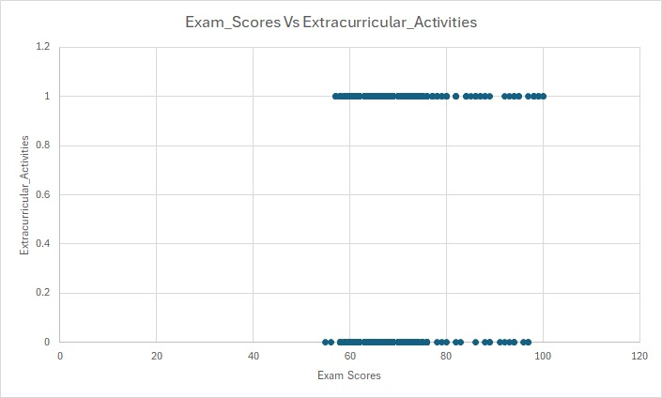
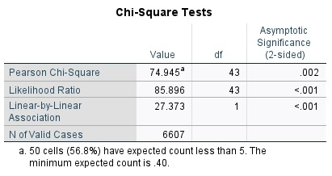
IMPACT OF EXTRACURRICULAR ACTIVITIES ON EXAM SCORES
Test Performed: Chi-Square Test
Final Statement: Rejecting Null Hypothesis and accepting Alternative Hypothesis.
Extracurricular activity is positively impacting the exam score and predicts the impact strongly.

Slide 12

HYPOTHESIS 5
Access to resources affects students' exam scores.
Null Hypothesis (H0): Access to resources has no significant effect on students' exam scores.
Alternative Hypothesis (H1): Access to resources has a significant effect on students' exam scores.
HYPOTHESIS 6
School type influences students' exam scores.
Null Hypothesis (H0): School type has no significant effect on students' exam scores.
Alternative Hypothesis (H1): School type has a significant effect on students' exam scores.
HYPOTHESIS 7
Parental education impacts students' exam scores.
Null Hypothesis (H0): Parental education has no significant effect on students' exam scores.
Alternative Hypothesis (H1): Parental education has a significant effect on students' exam scores.
Objective 3: Identify External Factors influencing exam scores

Slide 13
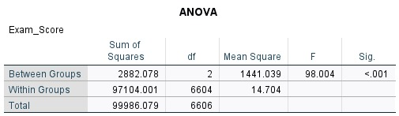
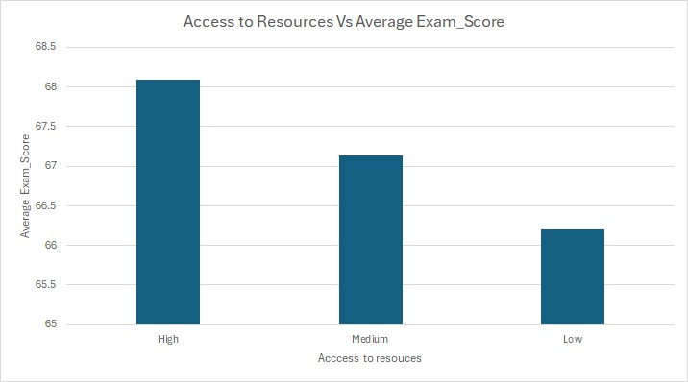
IMPACT OF ACCESS TO RESOURCES ON EXAM SCORES
Test Performed: One-way ANOVA
Final Statement: Rejecting Null Hypothesis and accepting Alternative Hypothesis.
Access to resources is positively impacting the exam score and predicts the impact strongly.

Slide 14
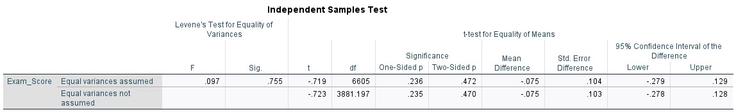
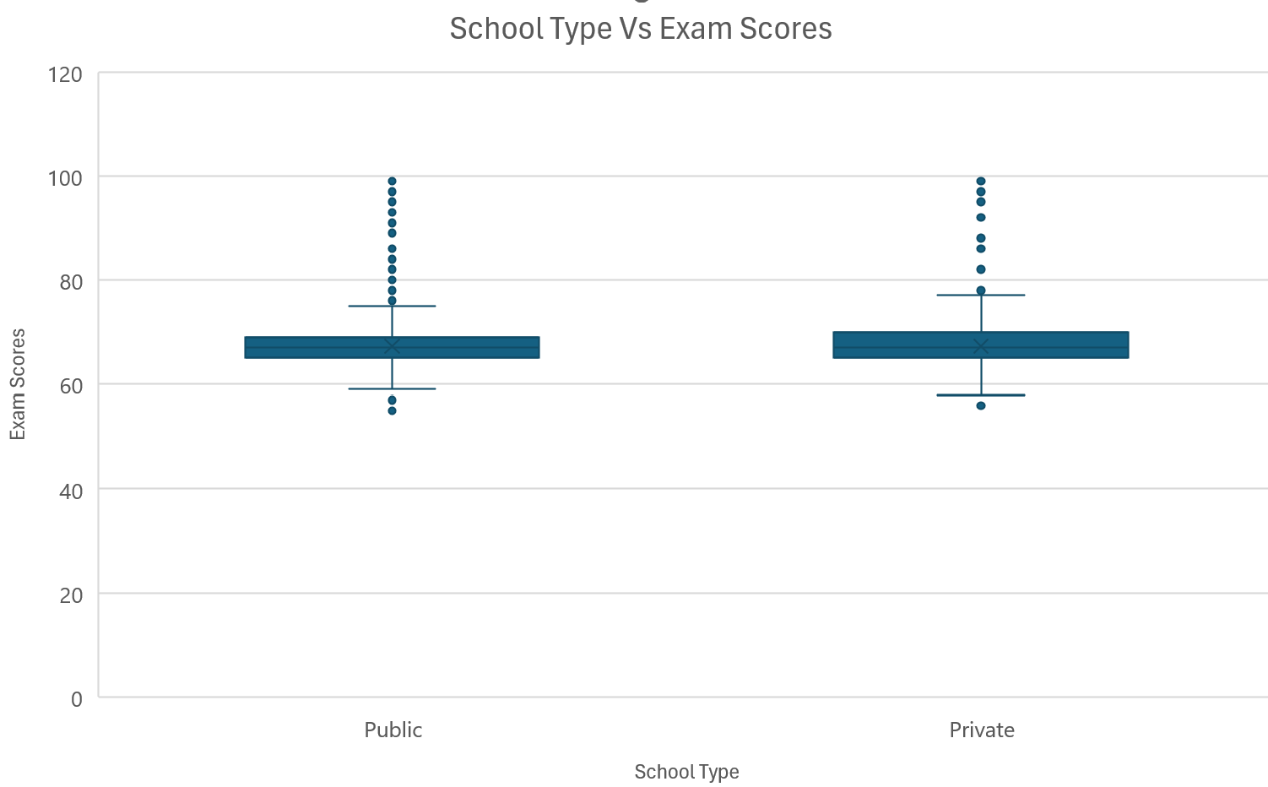
IMPACT OF SCHOOL TYPE ON EXAM SCORES
Test Performed: Independent T-Test
Final Statement: We are accepting the null hypothesis. The results suggest that school type does not have a significant impact on academic performance in this dataset. As significance (two-tailed p-value): 0.472 > 0.05.

Slide 15
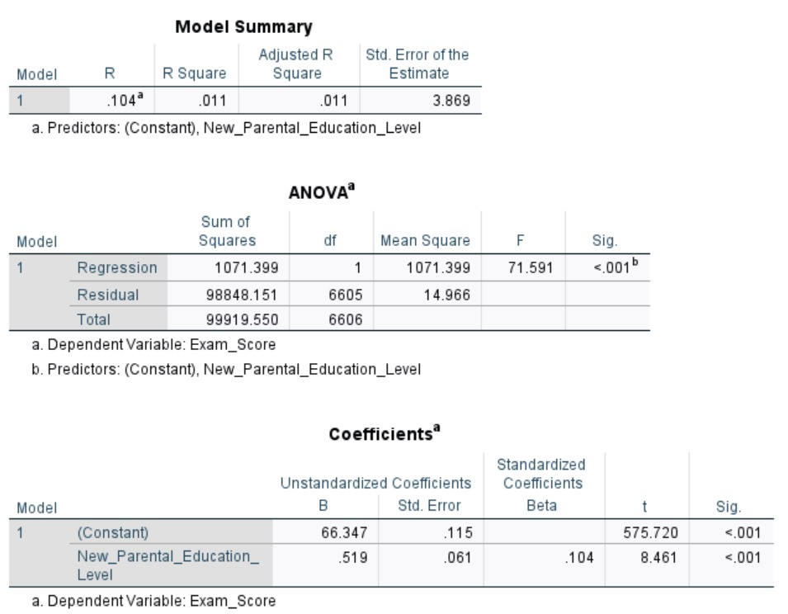
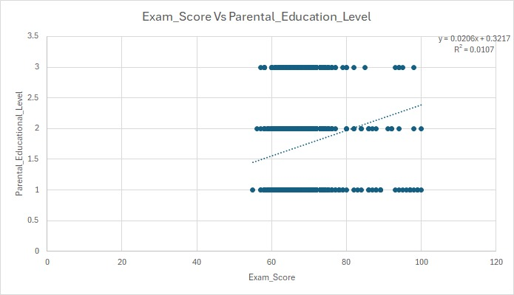
IMPACT OF PARENTAL EDUCATION LEVEL ON EXAM SCORES
Test Performed: Linear Regression
Final Statement: We are rejecting the null hypothesis and accepting alternative hypothesis.
The results suggest that parental education level have very weak impact on student’s exam score. As R Square: 0.011, indicating that only 1.1% of confidence level.

Slide 16
Recommendations based on Insights from Research Questions
For Parents
Encourage regular study habits and create a distraction-free study environment.
Support extracurricular involvement and provide access to learning resources.
Engage in their children's education through guidance and motivation, regardless of their educational background.
For Educational Institutions
Develop programs to ensure high attendance and active classroom engagement.
Invest in resource accessibility for all students, such as libraries, e-learning tools, and academic counseling.
Encourage peer learning through group projects and mentorship programs.
For Students
Balance study hours effectively with extracurricular activities to avoid burnout.
Build a supportive peer network that fosters healthy competition and collaboration.
Take advantage of resources provided by the school or community.

Slide 17
THANK YOU

